Slide 1
Computer Systems Organization Recitation CSCI-UA 0201-007
R01: Introduction & Environment Setup
Many slides are based on John Westhoff’s Fall 2019 CSO recitation

Slide 2
Logistics
Important things you should know

Slide 3
What is this recitation for?
Help you better understand the course contents, including but not limited to:
- Reinforce this week’s lecture content
- Review previous week’s assessment
- Some exercises meant to help with the labs/assessments
Make us all suffer by making us stay at school late

Slide 4
Where we release course materials
Course website
https://nyu-cso.github.io/
Recitation slides also on the course schedule page
NYU Brightspace
- Zoom recitation links/recording
CampusWire
It’s your responsibility to read Instructor’s Note on Campuswire
You are encouraged to ask questions on Campuswire
GitHub
- All labs are released on GitHub
You will submit all labs on both GitHub and Gradescope
Gradescope
- Weekly mini-quiz on Gradescope

Slide 5
How to contact us
Don’t be afraid to ask questions!
If you have general questions about course contents or labs
Ask on Campuswire
Come to office hours
Register the in-person recitation
If you want to send us a private message
- Email cso-staff mailing list at cso-staff@cs.nyu.edu
If you want more personal question answering

Slide 6
How are we going to proceed?
For the first two weeks, we will focus on lab setups, usage of basic tools, etc.
Today we will cover lab related setups
Next recitation will cover programming tools
From next week
We will review weekly assessment, reinforce some course contents, exercises to prepare for your labs
Weekly assessments will be due Friday 9pm EST
Done on Gradescope, do it early
No late submission

Slide 7
Academic Integrity
All work must be your own – do not copy or even look at assignments done by others
Don’t ask StackOverflow or Chegg for help - if you need it, ask us!
Don’t hire someone to do your work for you
We reserve the right to use software plagiarism detection tools such as Moss
It’s not worth the risk, just don’t cheat and make us sad
More details: https://nyu-cso.github.io/policy.html

Slide 8
Getting Started
Important things you must do

Slide 9
Today’s Topics
Log into snappy1
Setting up your git repositories
Basic Unix commands
Program development
Editor (Nano)
Version control (Git)

Slide 10
Today’s Goal
By the end of today’s recitation, your should
Be able to log into snappy1
Have GitHub ready for you to submit work
An account
Lab-1 repository
Know how to submit assignments

Slide 11
Log into snappy1
Follow https://nyu-cso.github.io/labs/ instructions
Separate instructions for Mac and Windows
Forget password?
https://cims.nyu.edu/webapps/password
Demo

Slide 12

Log into snappy1

Slide 13
Attention: You MUST test your code on snappy1
We recommend you to do your labs on snappy1 and test it before submission
More tools are available for debugging (gdb etc.)
Gradescope runs the same test script
In general, there should be no surprises
If you choose to do your labs outside of snappy1, we will not provide any technical support should you encounter any OS-related issues in doing the labs

Slide 14
I’m in snappy1, now what?

Slide 15
Basic Commands
Some useful commands to know:
man
ls, cd, pwd, mkdir
cp, mv, rm
echo, cat
wc
grep
ctrl-c,ctrl-d, ctrl-z, fg, bg
|, >, <, >>
apt install/search
history, ctrl-r

Slide 16
Basic Commands
Whenever you want to find out how to do something using command line, ask Google first
Here are some useful links:
A one-pager: https://nyu-cso.github.io/labs/linux_cheat_sheet
A more descriptive source: https://github.com/jlevy/the-art-of-command-line

Slide 17
Editor
You need a good editor to code with for productivity
Popular editors used by programmers:
vim
emacs
vscode
sublime
nano
We recommend you use nano
Unfortunately, vscode and sublime are not installed on snappy1
No self-respecting programmers use nano, but you can get by with nano in CSO

Slide 18
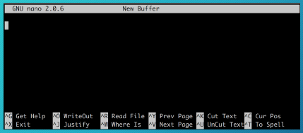
Brief Intro of Nano Editor
To create/edit a file
nano <Path to (Save) the File>
Edit
Hit Ctrl+O to save your changes (^ means Ctrl)
Hit Ctrl+X to exit

Slide 19
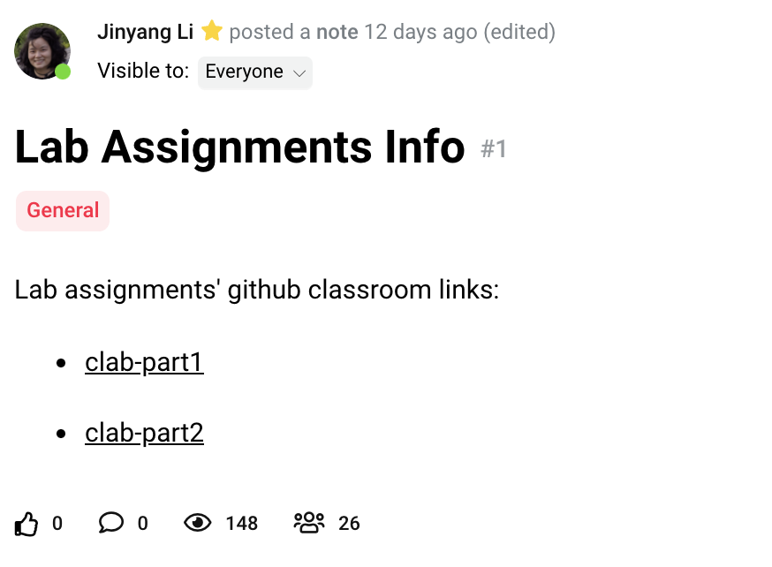
Setup GitHub/lab1 repo
Create a GitHub account if you don’t have one
We have created for you a corresponding private lab repository on Github.com
Enroll yourself in the GitHub classroom
Create your lab-1 repository by following the link posted on Campuswire
Select your NYU NetID
Very important!
Don’t select someone else’s NetID!
If you cannot find your NetID, let me know!
Setup GitHub ssh-based logins: https://nyu-cso.github.io/labs/#repo

Slide 20
Setup GitHub/lab1 repo

Slide 21
Git Overview
Create things
Save things
Edit things
Distributed version control system
What is version control?
Manages changes to documents, source files and other collections of information
Why is version control indispensable?
History tracking: track code changes
Roll back to older version
Collaborate with others (collaborative history tracking)
We are going to use the popular “Git” as our version control system
Save the thing again

Slide 22
You need to config git first!
git config --global user.email “<Your Email>”
git config --global user.name “<Your Name>”
You can issue “git config --list” to check your configuration
Here, the <Your Email> should be the one associated with your GitHub account

Slide 23
A list of git commands you need
git clone
git status
git remote
git add <file name>
git commit -m <commit messages>
git push origin master
git pull upstream master

Slide 24


Git Overview
GitHub
GitHub:
provides hosting for software development and version control using Git.
Pull assignments from GitHub (clone lab repo)
Submit assignments to GitHub
Make changes locally
snappy1

Slide 25
Clone your lab repo on Snappy
In command line, type:
mkdir cso-labs
cd cso-labs
git clone git@github.com:nyu-cso-fa21/clab-part1-<Your Github Username>.git clab-part1
If you copy the above command to command line, don’t let the line break
Replace <Your GitHub Username> (including the angle brackets) with your GitHub username.
cd clab-part1

Slide 26
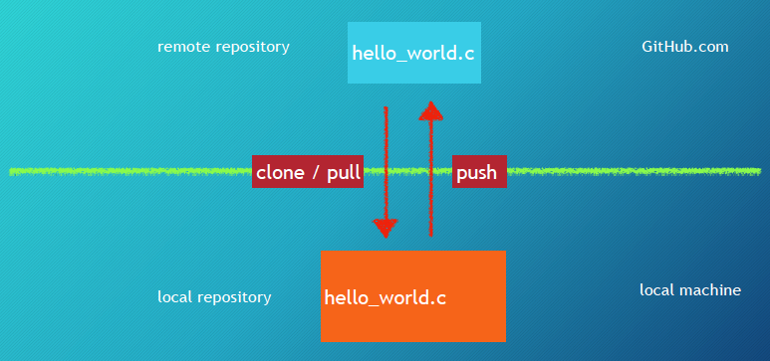
Git Setup
The remote copy is stored in some efficient format
stored on snappy1
Snappy1

Slide 27
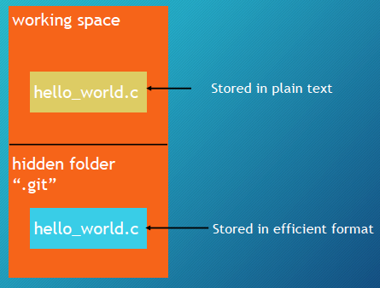
A closer look at your repository stored on snappy1
Local repository stored on snappy1

Slide 28
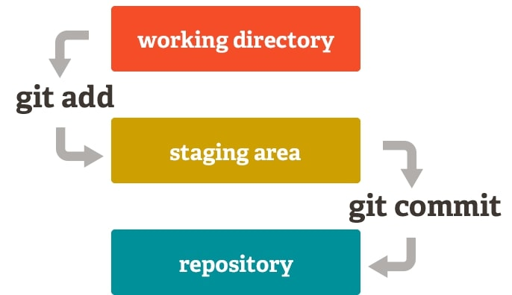
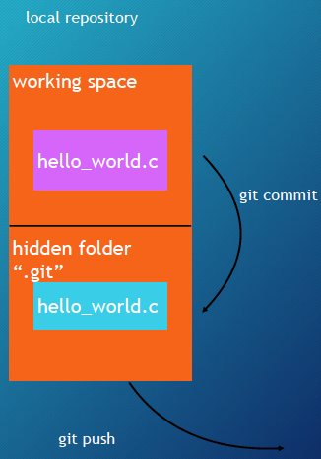

How to interact with Git
git add hello_world.c
Tell git to track changes to hello_world.c
git commit
Store tracked file to .git
git push origin master
Submit commits to your remote repository
Github.com

Slide 29
Git commit
When you issue “git commit”, you are required to provide a message which is a short description of the changes you made
Use "-m"/"--message" option to specify that
E.g.: git commit -m “my first commit”
Warning: please remember to add "-m"/"--message"
If you unfortunately forget:
a command line editor will pop up for you to edit the commit message
By default, vim, which is not really friendly to beginners (see the short guide in the end)

Slide 30
Double check with “git status”
Sometimes, you might forget to do some (or all) of
git add, git commit, git push
It’s always good to check the status of your repository
git status tells you
What files are going to commit
What files are not tracked
Whether you forget to push commits to remote

Slide 31
Triple check with GitHub
Still not sure/confident about whether commits was submitted properly?
Go to github.com, then go to your repo
Manually check if every file contains the up-to-date information

Slide 32
For each new assignment
Create lab repo on GitHub (click link, select yourself) (covered)
Clone your lab repo to snappy1
cd cso-labs
git clone git@github.com:nyu-cso-fa21/clab-part1-<YourGithubUsername>.git clab-part1
Make changes accordingly
Tell git to track changes: git add <Changed/Newly-Created Filenames>
Commit your changes
git commit -m “commit messages”
Push to your remote repository (on GitHub)
git push origin master

Slide 33
For each new assignment
Create lab repo on GitHub (click link, select yourself) (covered)
Clone your lab repo to snappy1
cd cso-labs
git clone git@github.com:nyu-cso-fa21/clab-part1-<YourGithubUsername>.git clab-part1
Make changes accordingly
Tell git to track changes: git add <Changed/Newly-Created Filenames>
Commit your changes
git commit -m “commit messages”
Push to your remote repository (on GitHub)
git push origin master

Slide 34
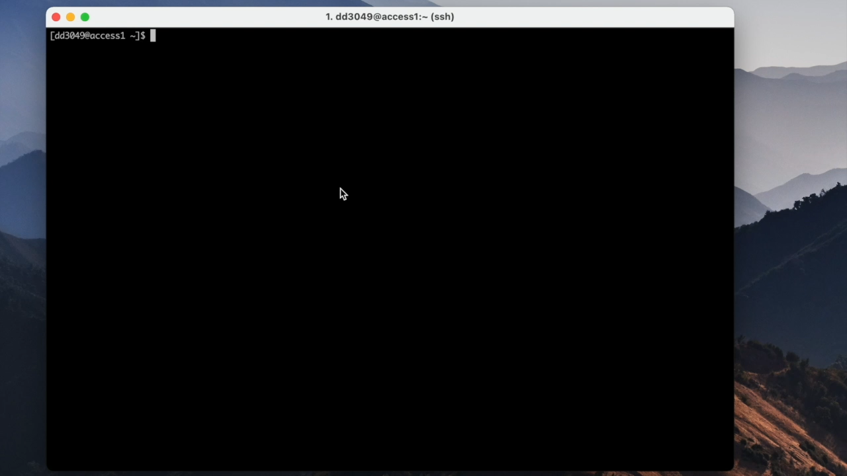
Git push commit demo

Slide 35

All the git commands you need for CSO
For beginners, it’s super easy to mess up Git
Notably conflicts, typically seen for collaboration, but not for individual usage
To avoid conflicts, only clone the repo once for each lab
After setting lab repository, you ONLY need to use the following git commands:
git add filenames
git commit -m “commit message”
git push origin master
git clone your-lab-repo lab
git status
Warning: unless you know what you are doing, do not use any other git commands or git command flags

Slide 36
Ask the staff for help
If you really cannot fix conflicts or other git problems, you should ask course staff for help
You need to email the staff or attend office hours
You should start your lab earlier
Don’t randomly issue commands to further mess things up

Slide 37
Things you should NEVER do
Don’t use git add *, git add .
Instead, you should always specify the file names you want to commit
Please don’t add complied programs to git
Don’t modify any file using GitHub website
Instead, you should always make changes on snappy1 and then push commits to GitHub
Otherwise, there will be conflicts, which will lead to sadness

Slide 38
Git is much powerful than that
Our git introduction only covers a small part of Git
Git tutorial:
https://www.atlassian.com/git/tutorials/what-is-versioncontrol
https://try.github.io/levels/1/challenges/1

Slide 39
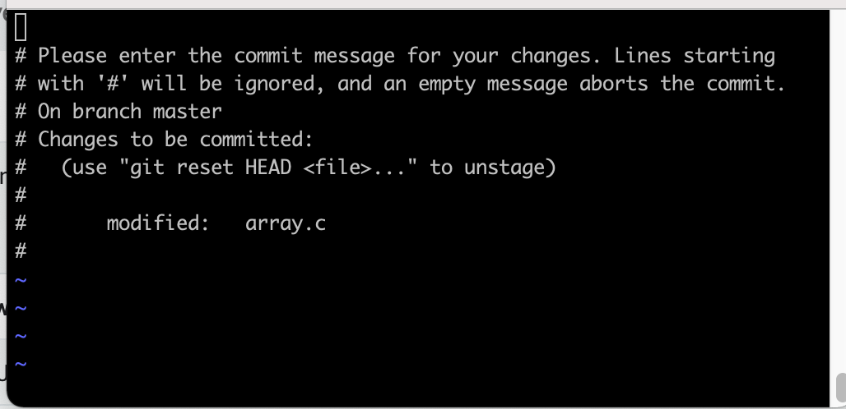
How to commit with Vim Editor (Optional)
The default editor is called Vim
To add a commit message from vim
First hit Esc (make sure you're in Normal mode)
Then hit "i" (entering Insert mode)
Then type in some commit message
Hit Esc (exiting Insert mode, going back to Normal mode)
Then type in ":wq" and press Enter (exit vim)
If you are lost, hit Esc and start from the beginning

